Slide 1
OPER 785 - Vanishing and Exploding Gradients
2d Lt Seth Allen
2d Lt Greg Barry
2d Lt Connor Shaw

Slide 2
Overview (Lesson Plan)
Review
Backpropagation
Gradients
Optimizers
Stochastic Gradient Descent
Unstable Gradient Problem
Vanishing Gradients
Exploding Gradients
Unstable Gradient Toolbox
Glorot/Xavier and He Initialization
Nonsaturating Activation Functions
Batch Normalization
Gradient Clipping
Code / Examples

Slide 3
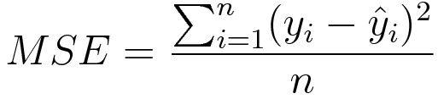
Backpropagation Review
Method used for training DNN models
Focus is on only altering weights for now
Crucial to understanding DNN functionality
Error (loss) function tells us how well we did at output layer
Mean square error, cross entropy loss, etc.
Aim is to minimize normally

Slide 4
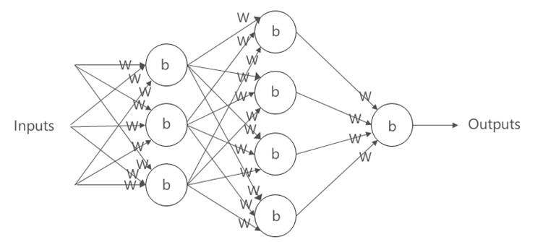
Backpropagation Review
Through the DNN layers, the chain rule is used to take gradients of our loss function and all the weights
This gradient systematically identifies nodes that contribute significantly to the loss function
Identifying good/bad nodes is used to iteratively alter their weights and reduce overall model error

Slide 5
Gradient Review
How is the gradient utilized?
Through backpropagation, all partial derivatives of the loss function with respect to each weight have been calculated
With use of different optimizers, an adjustment for each weight is determined
Goal is to identify optimal weights (w_{i}) which minimize the loss function

Slide 6
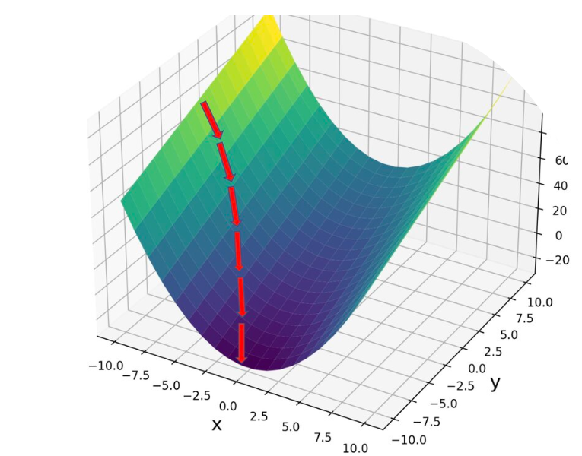
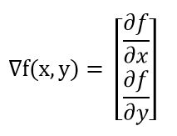
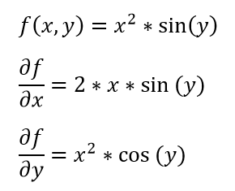
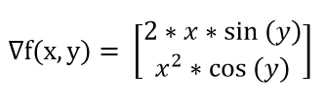
Gradient Review
https://math.etsu.edu/multicalc/prealpha/Chap2/Chap2-7/part3.html
https://programmathically.com/understanding-backpropagation-with-gradient-descent/
https://www.khanacademy.org/math/multivariable-calculus/multivariable-derivatives/gradient-and-directional-derivatives/v/gradient

Slide 7

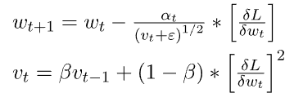

Optimizers
Many different algorithms utilize the gradient to efficiently find the global minimum
Gradient Descent
Root Mean Square Propagation (RMSProp)
Momentum
https://www.geeksforgeeks.org/intuition-of-adam-optimizer/

Slide 8
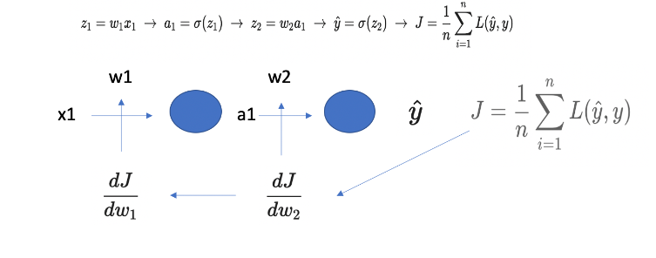




Simple NN Gradient Descent
https://programmathically.com/understanding-backpropagation-with-gradient-descent/

Slide 9
Unstable Gradients
“The vanishing gradient problem describes a situation encountered in the training of neural networks where the gradients used to update the weights shrink exponentially. As a consequence, the weights are not updated anymore, and learning stalls.”
“The exploding gradient problem describes a situation in the training of neural networks where the gradients used to update the weights grow exponentially. This prevents the backpropagation algorithm from making reasonable updates to the weights, and learning becomes unstable.”
https://programmathically.com/understanding-the-exploding-and-vanishing-gradients-problem/
Notes:
https://programmathically.com/understanding-the-exploding-and-vanishing-gradients-problem/

Slide 10
VGP - Why does it occur?
Recall, from backpropagation, that the gradient of the loss to any given weight is going to be the product of some derivatives that depend on components that reside later in the network
The closer to the inputs a weight lives, the more terms will be needed to calculate the gradient of the loss with respect to this weight
Small numbers multiplied by small numbers results in even smaller numbers, stalling the potential to change

Slide 11
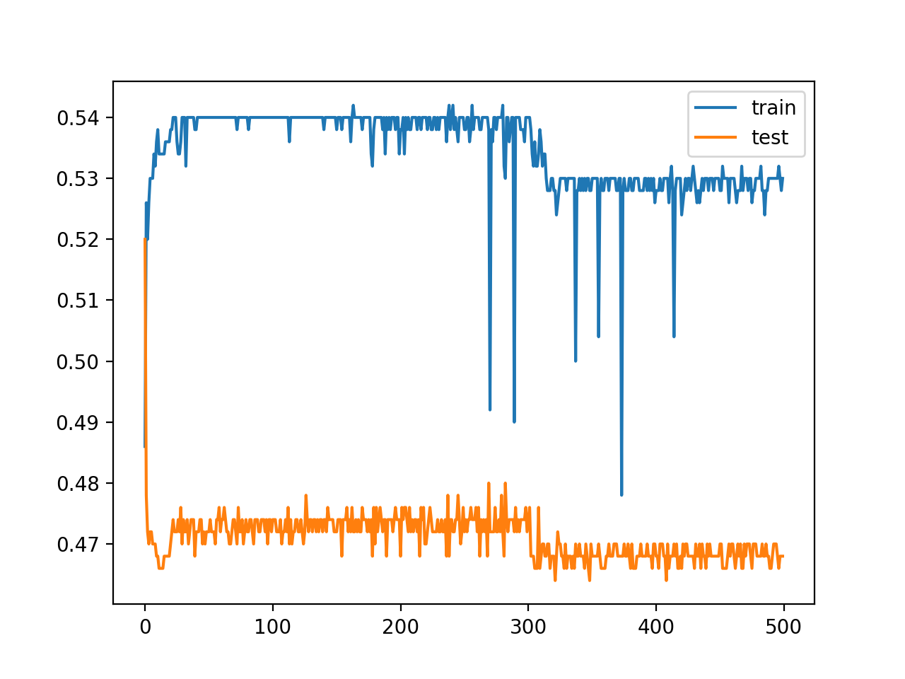
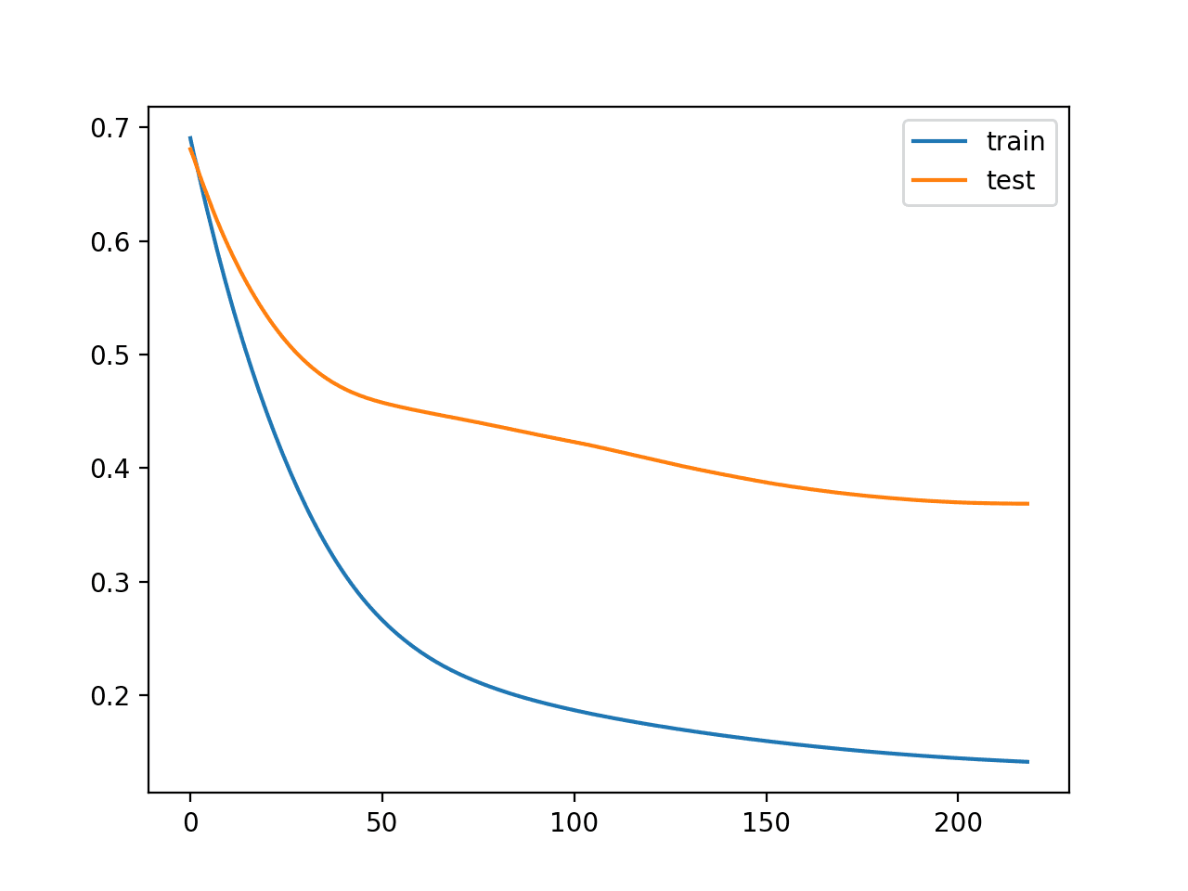
Vanishing Gradient Problem
Loss
Loss
Epochs
Epochs

Slide 12
EGP - Why does it occur?
With a large gradient, a big step will be taken to correct it
With multiple large gradients following each other, exponentially increasing steps are taken
Will most likely force the algorithm to diverge and return NaN responses and weights due to size
Model taking multiple large steps simultaneously fails to find a better solution, may overshoot

Slide 13
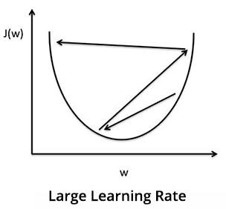
Exploding Gradient Problem

Slide 14
Solution Toolbox
Glorot/Xavier and He Initialization
Nonsaturating Activation Functions
Batch Normalization
Gradient Clipping

Slide 15
Initialization
The “industry standard” now, randomizing initial weights
Speeds up training drastically
Helps avoid getting stuck at local minimums
“For the signal to flow properly, the authors argue that we need the variance of the outputs of each layer to be equal to the variance of its inputs” (Geron 2019)
Notes:
https://machinelearningmastery.com/weight-initialization-for-deep-learning-neural-networks/

Slide 16
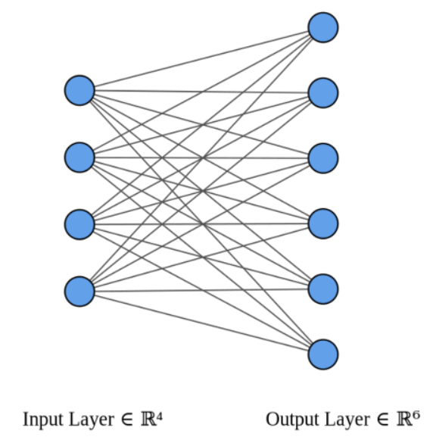
fan_{in} and fan_{out}
https://stackoverflow.com/questions/42670274/how-to-calculate-fan-in-and-fan-out-in-xavier-initialization-for-neural-networks
Notes:
https://stackoverflow.com/questions/42670274/how-to-calculate-fan-in-and-fan-out-in-xavier-initialization-for-neural-networks

Slide 17
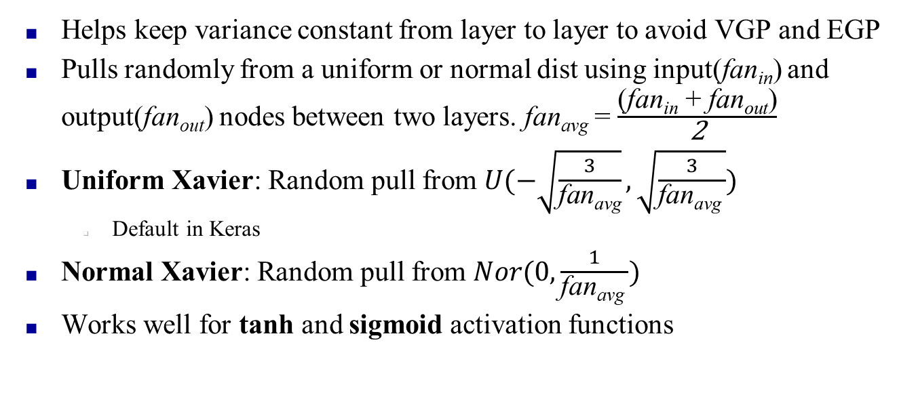
Xavier Glorot Init
Helps keep variance constant from layer to layer to avoid VGP and EGP
Pulls randomly from a uniform or normal dist using input(fan_{in}) and output(fan_{out}) nodes between two layers. fan_{avg} = $\frac{\text{(}\text{fan}\text{in} \text{+ }\text{fan}\text{out}\text{)}}{\text{2}}$
Uniform Xavier: Random pull from $U(−\sqrt{\frac{3}{\text{fan}\text{avg}}},\sqrt{\frac{3}{\text{fan}\text{avg} }})$
Default in Keras
Normal Xavier: Random pull from $Nor(0,\frac{1}{\text{fan}\text{avg} })$
Works well for tanh and sigmoid activation functions
Notes:
https://machinelearningmastery.com/weight-initialization-for-deep-learning-neural-networks/

Slide 18
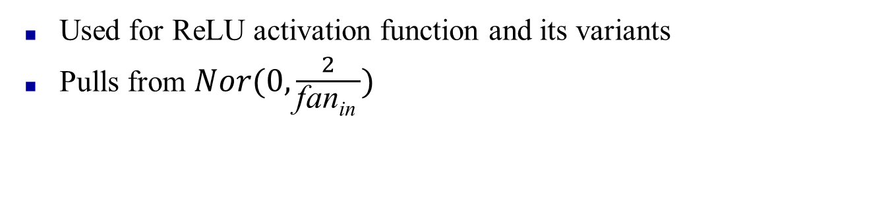
He Initialization
Used for ReLU activation function and its variants
Pulls from $Nor(0,\frac{2}{\text{fan}\text{in} })$
Python Code
keras.layers.Dense(10, activation="relu", kernel_initializer="he_normal")
keras.layers.Dense(10, activation="relu", kernel_initializer="he_uniform")
Remember: It defaults to Glorot uniform if not specified.

Slide 19
Nonsaturating Activation Functions
Vanishing/exploding gradients caused in part by choice of weaker activation functions
Though biological neurons use sigmoid, others work better in deep neural networks for intelligent computations
Textbook highlights variations of ReLU

Slide 20
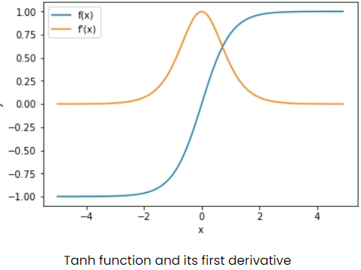

Nonsaturation Visual
Saturation region: $\left(−∞,−2\right)∩\left(2,∞\right)$
Stops learning because $f^{′}\left(x\right)=0$
Notes:
https://adventuresinmachinelearning.com/weight-initialization-tutorial-tensorflow/

Slide 21
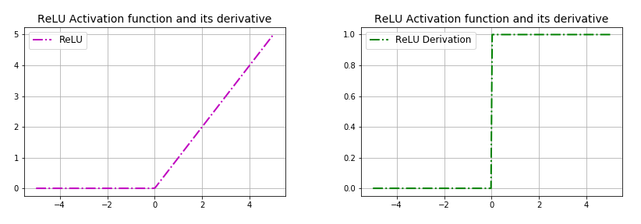
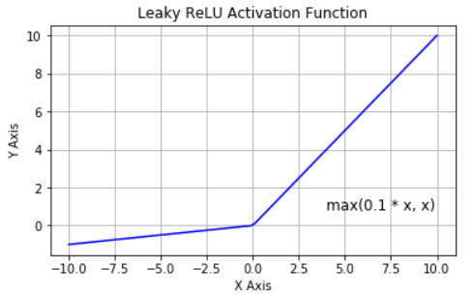
ReLU Variations
Randomized RReLU
Parametric leaky ReLU (PReLU)
Exponential Linear Unit
https://medium.com/@kanchansarkar/relu-not-a-differentiable-function-why-used-in-gradient-based-optimization-7fef3a4cecec
https://www.researchgate.net/figure/Plot-of-the-LeakyReLU-function_fig9_325226633

Slide 22
Batch Normalization (Batch Norm)
Technique consists of adding an operation in the model just before or after the activation function of each hidden layer
Zero-centering and normalizing each input
Scale and shift the result using two new parameter vectors per layer
One parameter for scaling and one for shifting
Ultimately, these operations let the model learn the optimal scale and mean of each of the layers’ inputs
Notes:
He initialization and any variation of ReLU should be done first, and then if exploding/vanishing gradients come back during training try something like batch normalization.
Normalize and Standardize data as part of the pre-processing step

Slide 23



Batch Normalization (Batch Norm)
Normalize the output from activation function
Multiply normalized output by arbitrary parameter, g
Add arbitrary parameter, b, to resulting product
m, s, g, and b are all tuneable and will be optimized during training
https://www.youtube.com/watch?v=dXB-KQYkzNU
Notes:
This makes the weights within the network don’t become unbalanced with high or low values.

Slide 24
Batch Normalization (Batch Norm)
Increases the speed of training
Reduce probability of outlying large weights which cause vanishing/exploding gradients
Occurs on a per batch basis
The batch size is the number of samples that will be passed through the network before any adjustments are made
Predetermined size when you train your model
https://www.youtube.com/watch?v=U4WB9p6ODjM
Notes:
This makes the weights within the network don’t become unbalanced with high or low values.

Slide 25
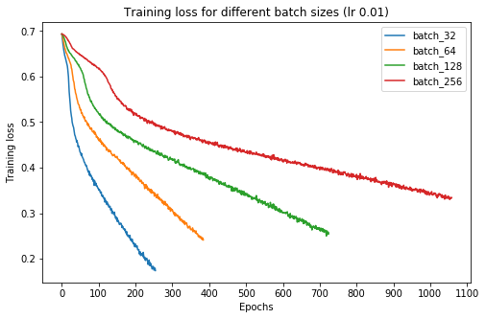
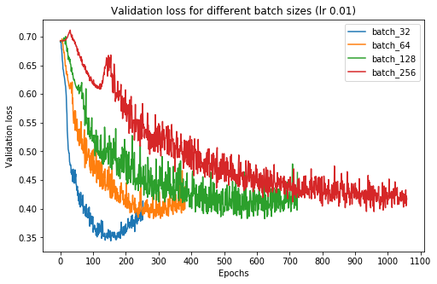
Batch Review
https://medium.com/deep-learning-experiments/effect-of-batch-size-on-neural-net-training-c5ae8516e57

Slide 26
Gradient Clipping
“Clips” the gradients during backpropagation so they never exceed some threshold
Fix for exploding gradients
Primarily used for recurrent neural networks because it’s easier to implement than batch normalization
No hard rule for the right gradient clip
Try normal gradient clipping
Try normalized gradient clipping
Try different threshold values

Slide 27
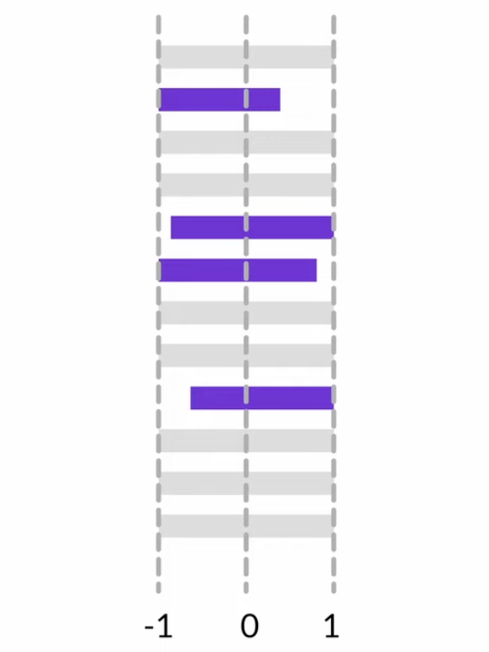
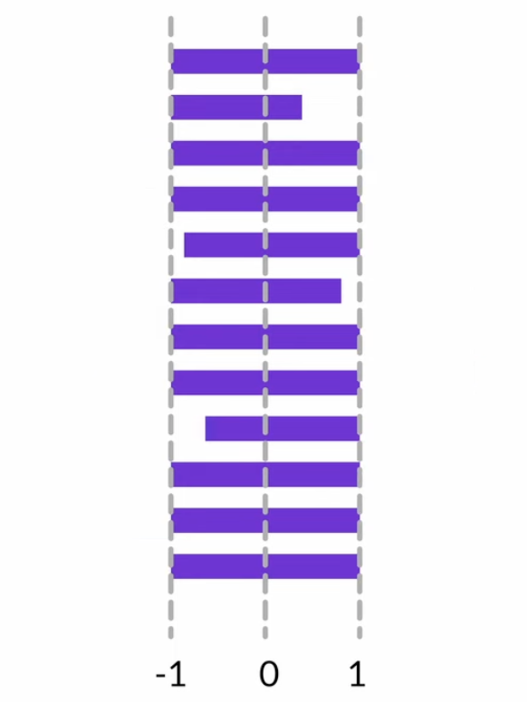
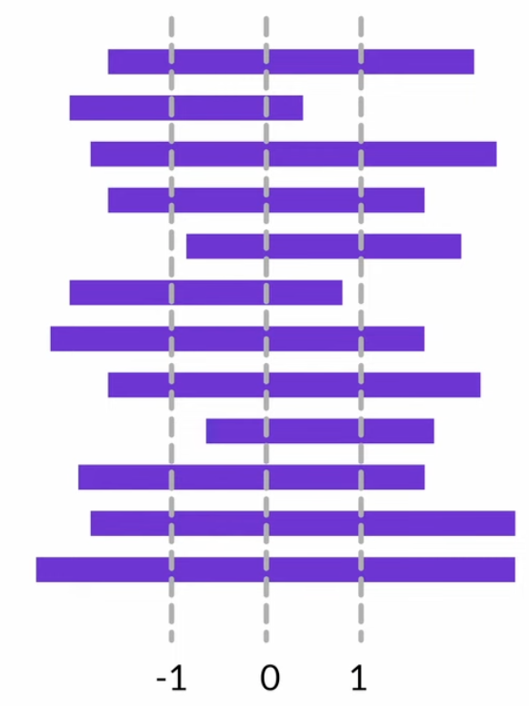
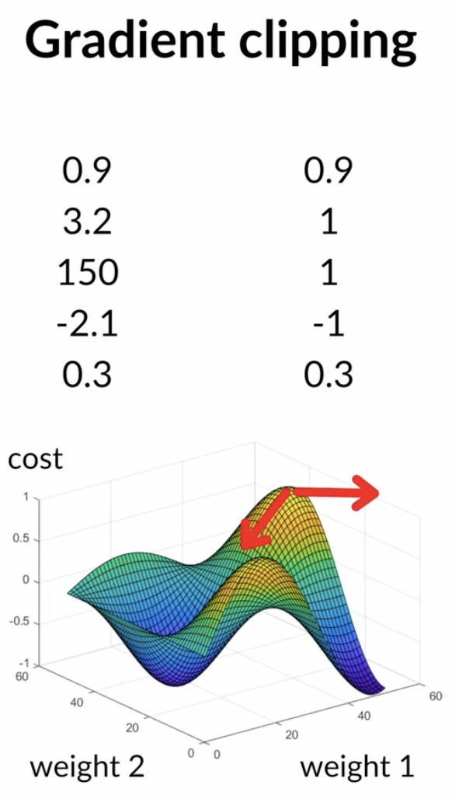
Gradient Clipping
https://www.youtube.com/watch?v=KrQp1TxTCUY

Slide 28
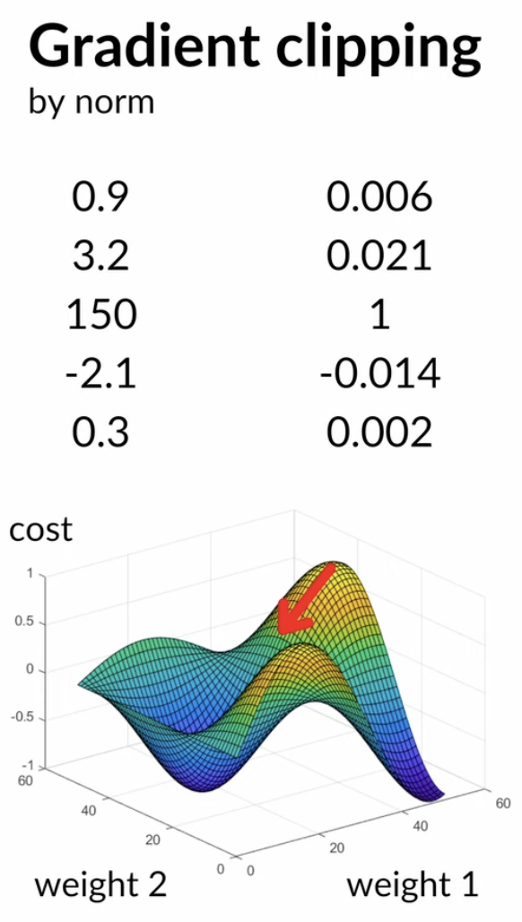
Gradient Clipping
https://www.youtube.com/watch?v=KrQp1TxTCUY

Slide 29
Questions?

